Slide 1
The drawbacks of IPv4
1. Despite all short-term solutions, such as
• Sub-netting, Classless addressing and NAT
Address depletion is still a long-term problem in the Internet.
2. The Internet must accommodate real-time audio and video transmission that requires minimum delay strategies and reservation of resources are not provided in IPv4.
3. The Internet must provide encryption and authentication of data for some applications. No encryption or authentication is provided by IPv4.

Slide 2
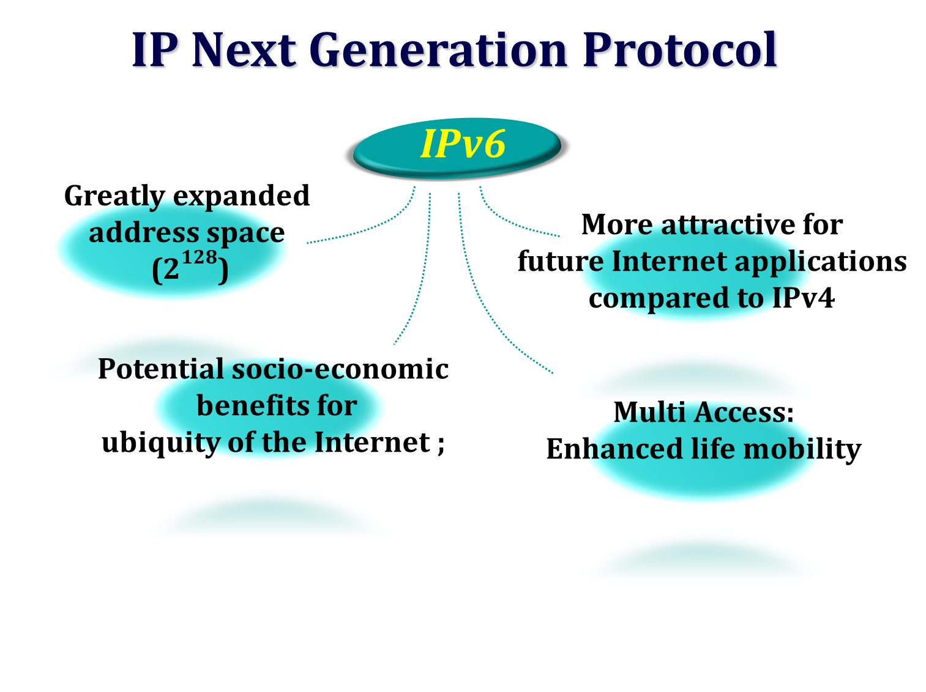
(Week 8) Session -7 Network Layer Protocol- IPv6

Slide 3
Why IPv6
Shortage of IPv4 addresses
Internet is expanding very rapidly in developing countries like India, China
New devices like phones need IP address
End-to-End Reachability is not possible without IPv6
New Features like Autoconfiguration, better support for QoS, Mobility and Security, Route Aggregation, Jumbo Frames

Slide 4
The advantages are:
Larger address space
An IPv6 address is 128 bits long. Compared with the 32-bit address of IPv4
Is a huge (2^96) increase in the address space.
Better header format
IPv6 uses a new header format in which options are separated from the base header and inserted, when needed.
New options
IPv6 has new options to allow for additional functionalities.
Allowance for extension
IPv6 is designed to allow the extension of the protocol if required by new technologies or applications.
Support for resource allocation
In IPv6 a mechanism called flow label has been added to enable the source to request special handling of the packet such as real-time audio and video.
Support for more security
The encryption and authentication options provide confidentiality and integrity of the packet.

Slide 5
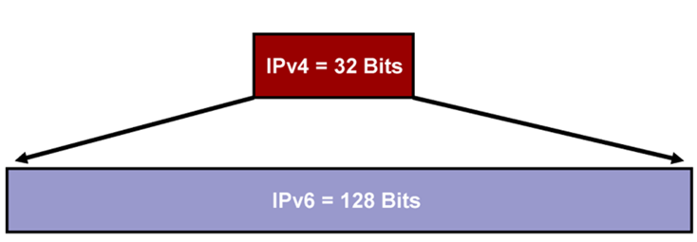
IPv6
IPv4: 32 bits or 4 bytes long
4,200,000,000 possible addressable nodes
IPv6: 128 bits or 16 bytes
3.4 * 10³⁸ possible addressable nodes
340,282,366,920,938,463,374,607,432,768,211,456
5 * 10²⁸ addresses per person
Separated by colon, eg:
Not case sensitive
Classless Interdomain Routing
Address Auto configuration

Slide 6
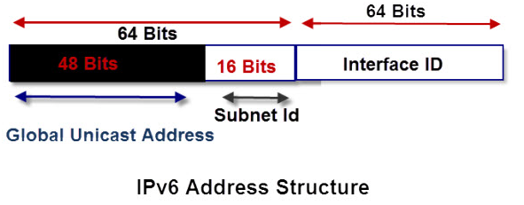
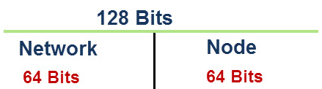
Do not use broadcasting message ,
only use multicast and anycast
Simple and efficient addressing structure
Hierarchical and contiguous
Provides for better route summarization(smaller, easier to understand routing tables)
Less complicated network mask
/64 is the standard and default host prefix length
Integrated security and better support for QOS

Slide 7



An IPv6 address is made of 128 bits divided into eight 16-bits blocks. Each block is then converted into
4-digit Hexadecimal numbers separated by colon symbols.
For example, given below is a 128 bit IPv6 address represented in binary format and divided into eight 16-bits blocks:
Each block is then converted into Hexadecimal and separated by ‘:’ symbol:
Even after converting into Hexadecimal format, IPv6 address remains long. IPv6 provides some rules to shorten the address.
The rules (Address Abbreviation Rule)are as follows
Rule.1: Discard leading Zero(es):
In Block 5, 0063, the leading two 0s can be omitted, such as (5th block):
Rule.2: If two or more blocks contain consecutive zeroes, omit them all and replace with double colon sign :: , such as (6th and 7th block) - Consecutive blocks of zeroes can be replaced only once by ::
Rule.3: so if there are still blocks of zeroes in the address, they can be shrunk down to a single zero, such as (2nd block):

Slide 8
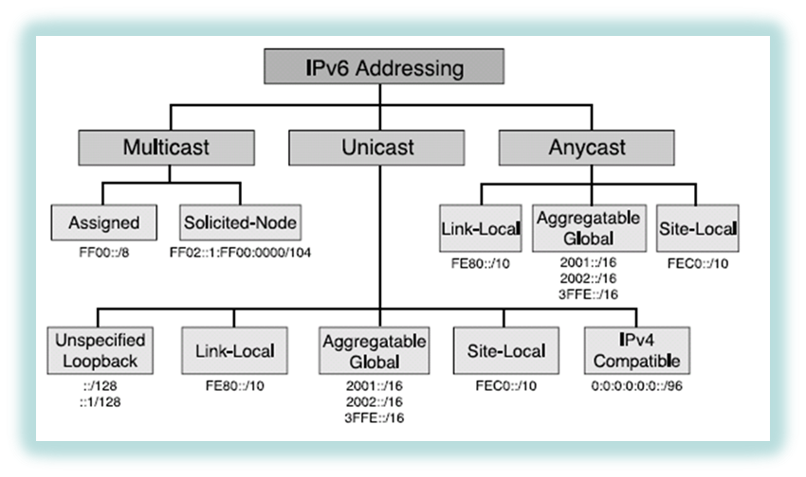
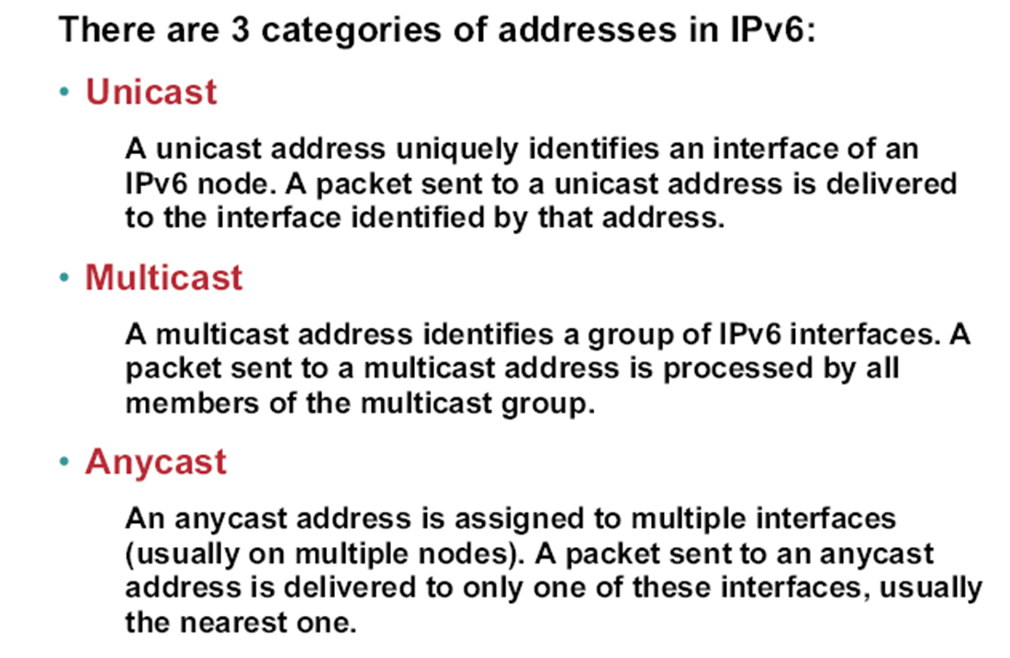
IPv6 Addressing

Slide 9
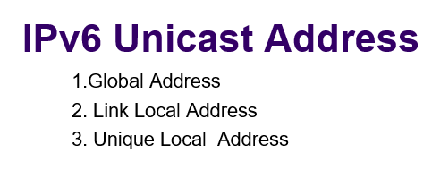
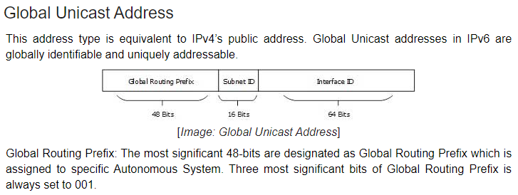
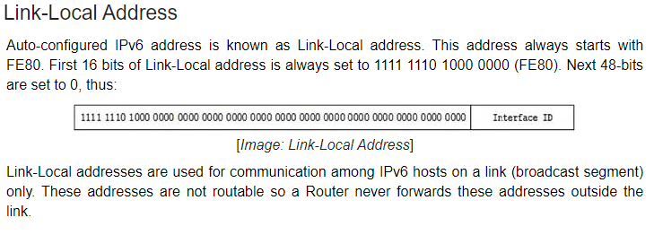
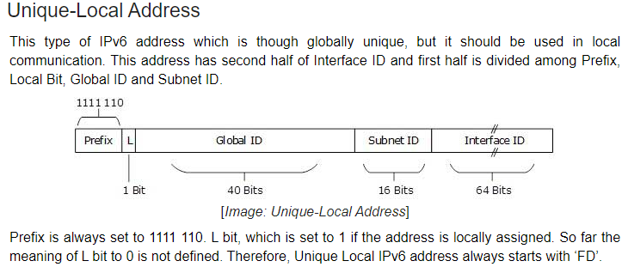
FC

Slide 10
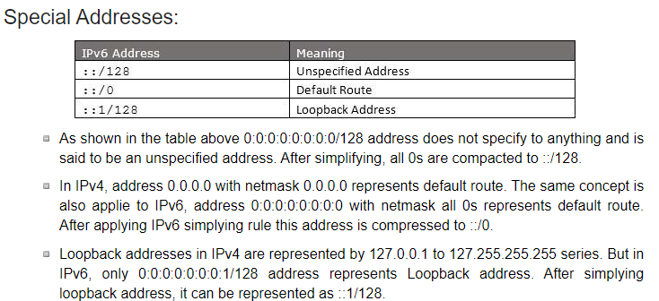
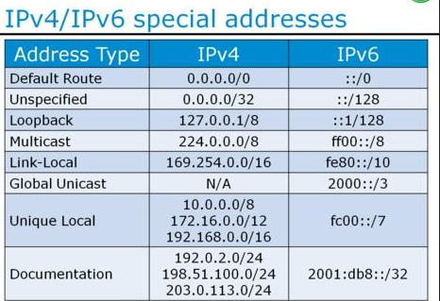

Slide 11
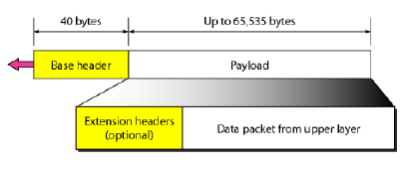
IPv6 Packet Format
• The IPv6 packet is shown below.
• Each packet is composed of
A mandatory Base Header (40 Bytes) followed by the Payload (65,535 Bytes) of information.
• The payload consists of two parts:
Optional extension headers
Data from upper layers.

Slide 12
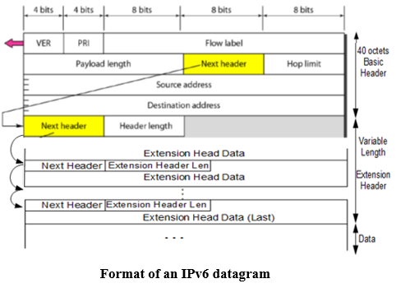
Format of IPv6 Datagram
Version
The 4-bit field
Defines the version number of the IP is 6
Priority / Traffic class
The 4-bit priority field defines the priority of the packet
With respect to traffic congestion.
Flow label
3-Byte (24-bit) field
Designed to provide special handling Particular flow of data.
Payload length
2-byte payload length field
Defines the length of the IP datagram Excluding the base header.
Next header
8-bit field defines, the header that follows the base header in the datagram.
Hop limit
8-bit hop limit field serves the same purpose as the TTL field in IPv4.

Slide 13
Format of IPv6 Datagram
Source address
16-Byte (128-bit) Internet address
Identifies the original source of the datagram.
Destination address
16-byte (128-bit) Internet address
Identifies the final destination of the datagram.
If source routing is used -Contains the address of the next router.
Priority
The 4-bit priority field defines the priority of the packet With respect to traffic congestion.
The priority field of the IPv6 packet defines
Priority of each packet with respect to other packets
-From same source.
IPv6 divides traffic into two broad categories:
- Congestion Controlled – (0 to 7)
If a source adapts itself to traffic slowdown when there is Congestion, the traffic is referred to as congestion-controlled traffic.
- Non-Congestion Controlled. (8 to 15)

Slide 14
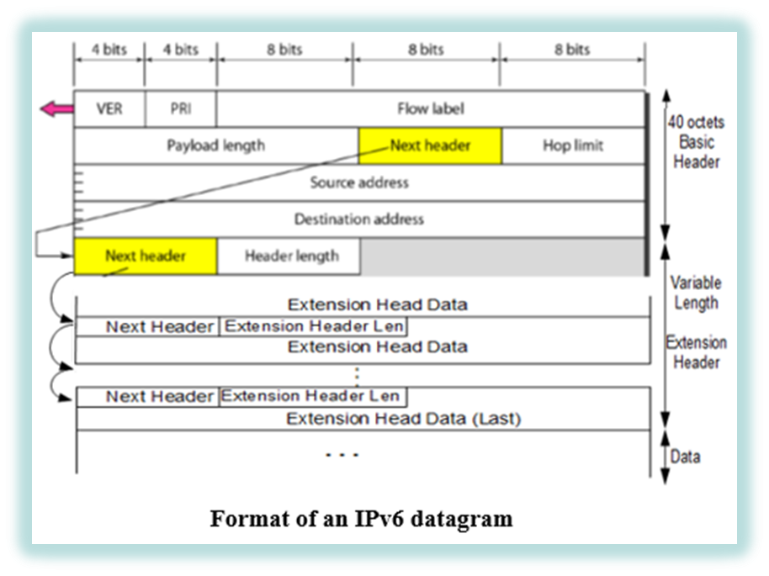
Flow Label
• To a router, a flow is a sequence of packets that share the same characteristics,
such as traveling the same path, using the same resources, having the same kind of security, etc.
sent from a source to a destination that needs special handling is called flow of packets.
The combination of source address and the flow label uniquely define a flow of packets.
A router that supports the handling of flow labels has a flow label table.
Extension Headers
• The length of the base header is fixed at 40 bytes.
Gives greater functionality to the IP datagram,
Can be followed by up to six extension headers.
Many of these headers are options in IPv6.
• Six types of extension headers are:

Slide 15

• Six types of extension headers are:
Hop-by-Hop Option
Used when the source needs to pass information to all routers visited by the datagram. The three options are Pad-1, Pad-N, and jumbo payload.
The Pad1 and Pad-N option is designed for alignment purposes.
The jumbo payload option
-Define a payload longer than 65,535 bytes.
2. Source Routing
Combines the concepts of the strict source route and the loose source route options of IPv4.
3. Fragmentation
Only the original source can fragment.
A source must use a path MTU discovery technique to find the smallest MTU
supported by any network on the path.
The source then fragments using this knowledge.
4. Authentication
Validates the message sender and ensures the integrity of data.
5. Encrypted Security Payload
An extension that provides confidentiality and guards against eavesdropping.
6. Destination Option
Used when the source needs to pass information to destination only.
Intermediate routers cannot access this information.

Slide 16
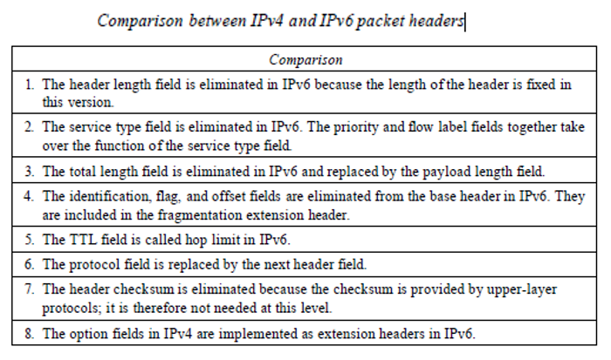

Slide 17
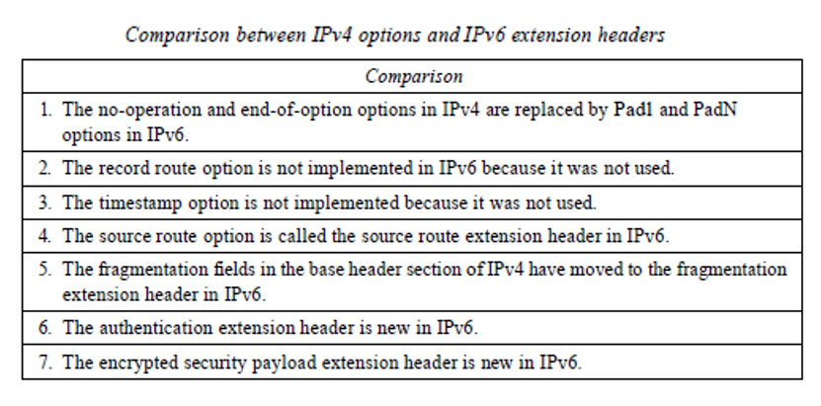

Slide 18
Review Questions
Which character(s) are used to express a string of zeros inside of a IPv6 address?
How many bits are in an IPv6 address?
In the IPv6 header, the traffic class (priority field) is similar to which field in the IPv4 header?
IPv6 does not use _________ type of address.
The _________ field determines the lifetime of IPv6 datagram

Slide 19
Answers
::
128
TOS
Broadcast
Hop limit

Slide 20

Routing Issues: Delivery, Forwarding, and Routing

Slide 21
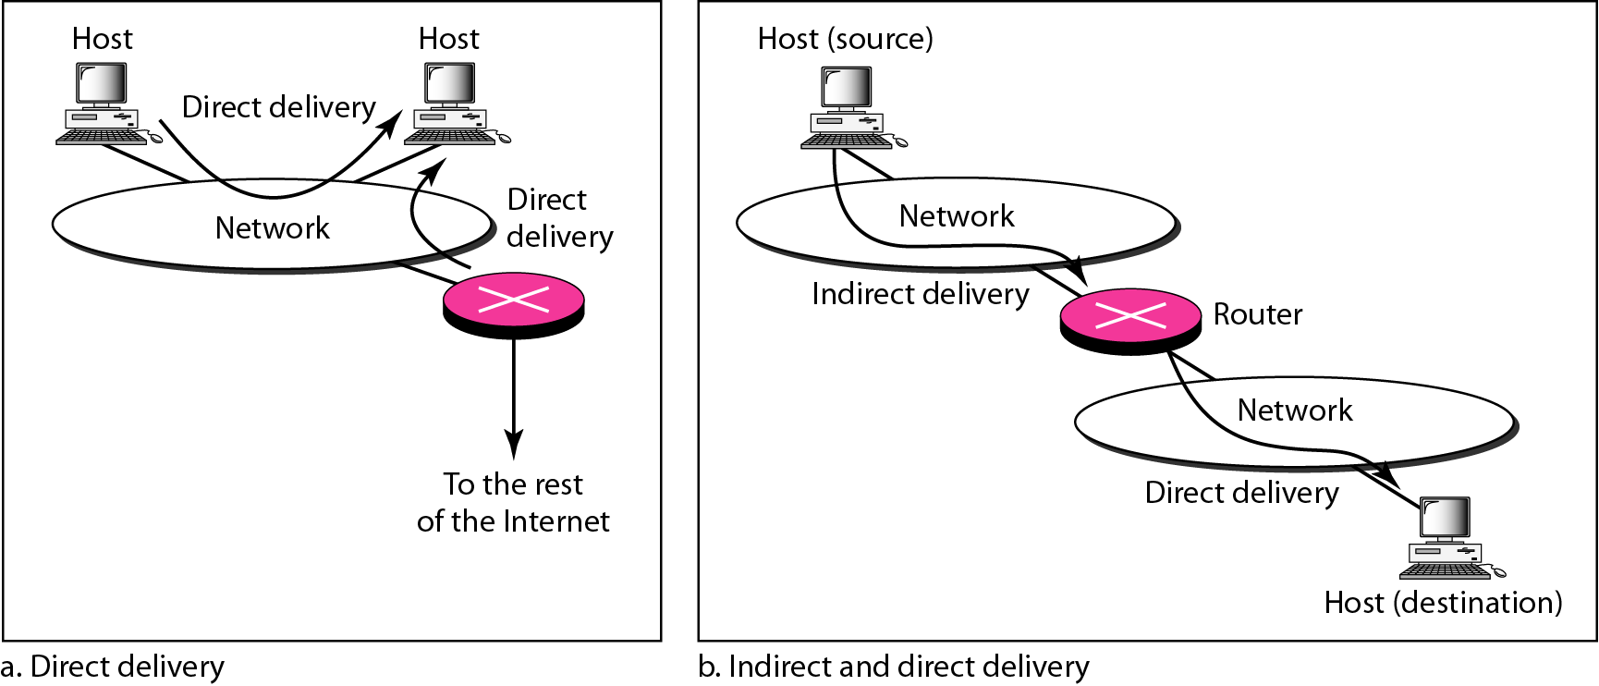
Delivery
The network layer supervises the handling of the packets by the underlying physical networks. We define this handling as the delivery of a packet.
Direct versus Indirect Delivery

Slide 22
Forwarding
Forwarding means to place the packet in its route to its destination.
Forwarding requires a host or a router to have a routing table
Forwarding techniques to make the size of the routing table manageable
Next-hop method versus source route method
Network-specific method versus host-specific method
Default method

Slide 23
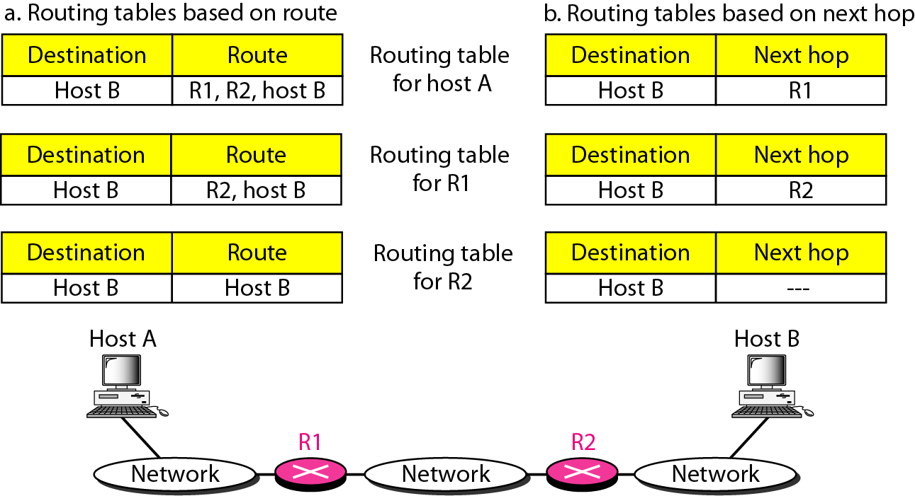
Forwarding Techniques
It makes the size of the routing table manageable and also handle issues such as security.
Route method versus next-hop method

Slide 24
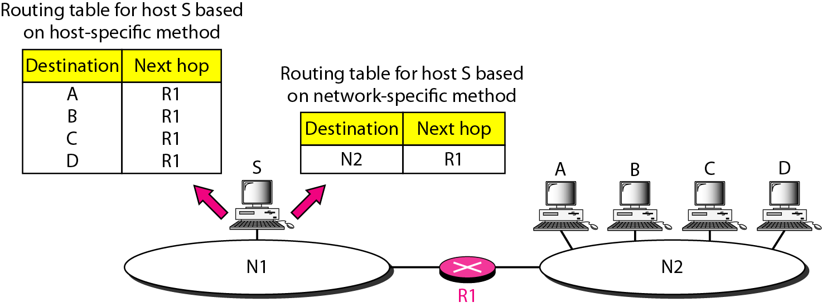
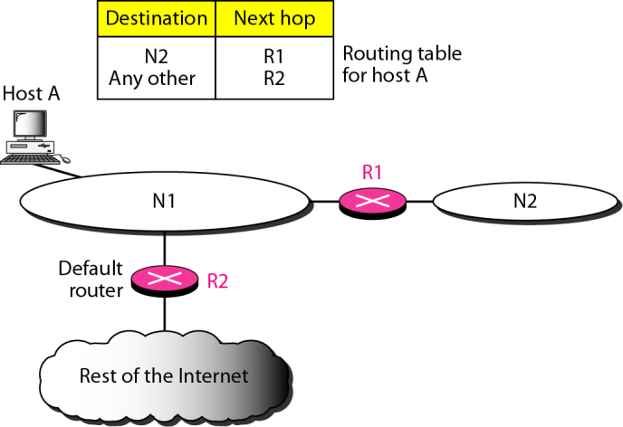
Forwarding Techniques
Host –specific versus network-specific method
Default method

Slide 25
Network Specific method
Network specific method reduces the routing table and simplifies the searching process.
Instead of having an entry for every destination host connected to same physical network , only one entry that defines the address of the destination network.
In other words, we treat all hosts connected to same network as one single entity.

Slide 26
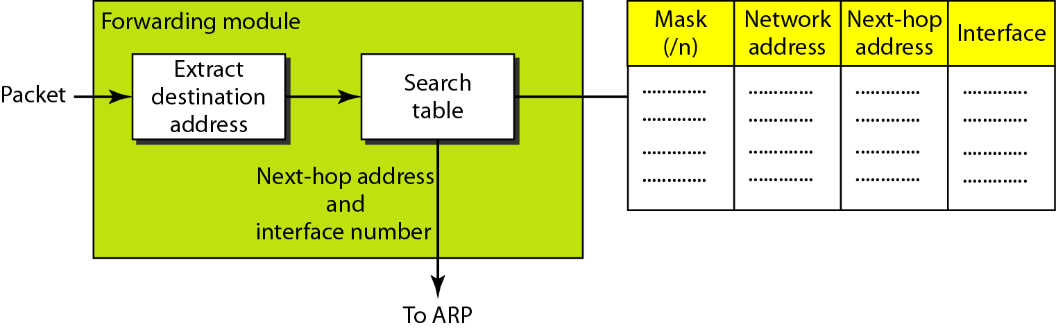
Forwarding Process
In classless addressing, we need at least four columns in a routing table

Slide 27
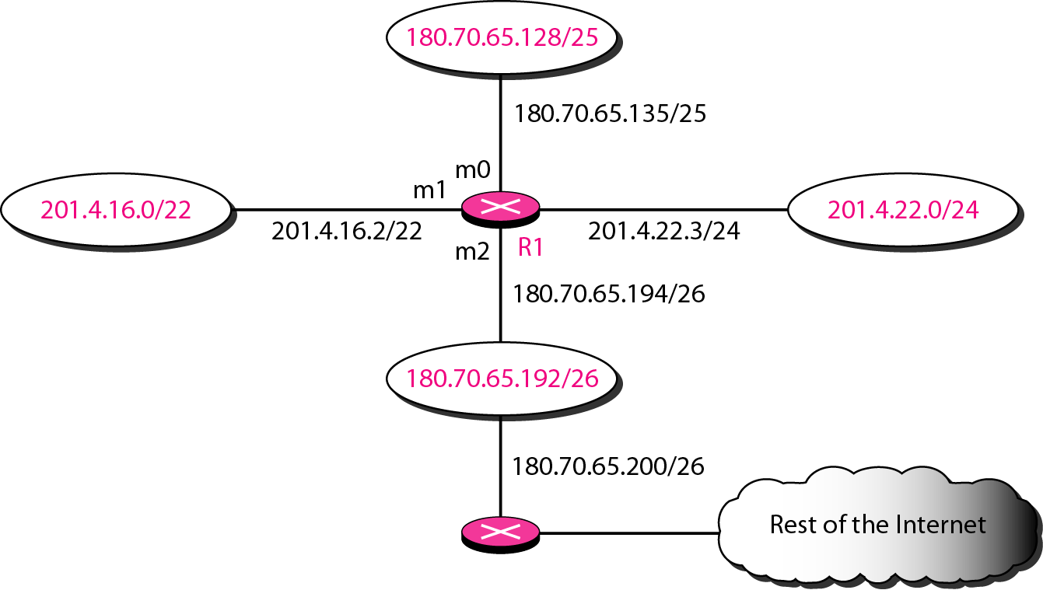
Example
Make a routing table for router R1, using the configuration in Figure

Slide 28
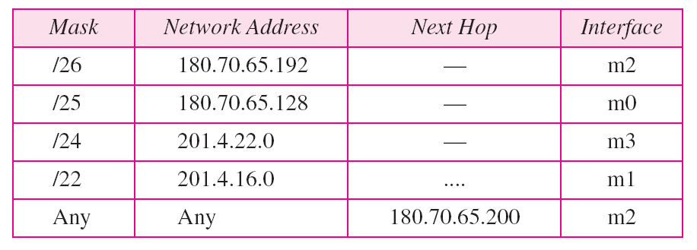
Example
Routing table for router R1
Forwarding process for the destination address 180.70.65.140 ?
Forwarding process for the destination address 18.24.32.78 ?

Slide 29
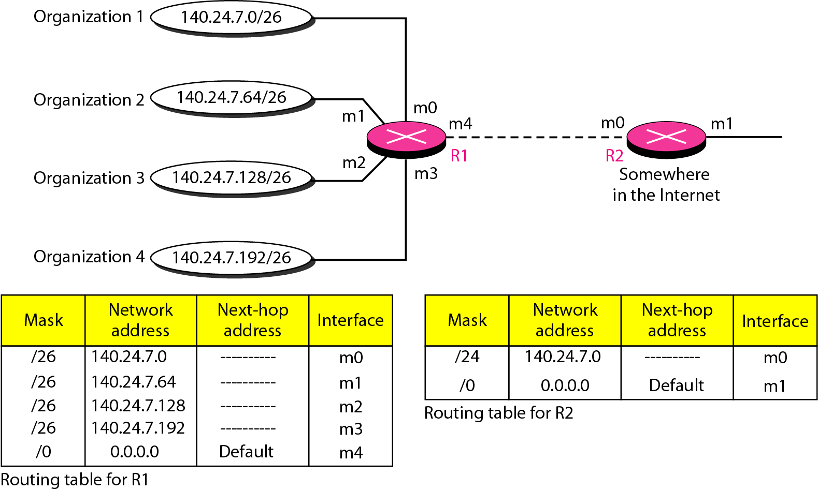
Address Aggregation
Classless addressing increases the number of routing table entries
To alleviate the problem, the address aggregation is used

Slide 30
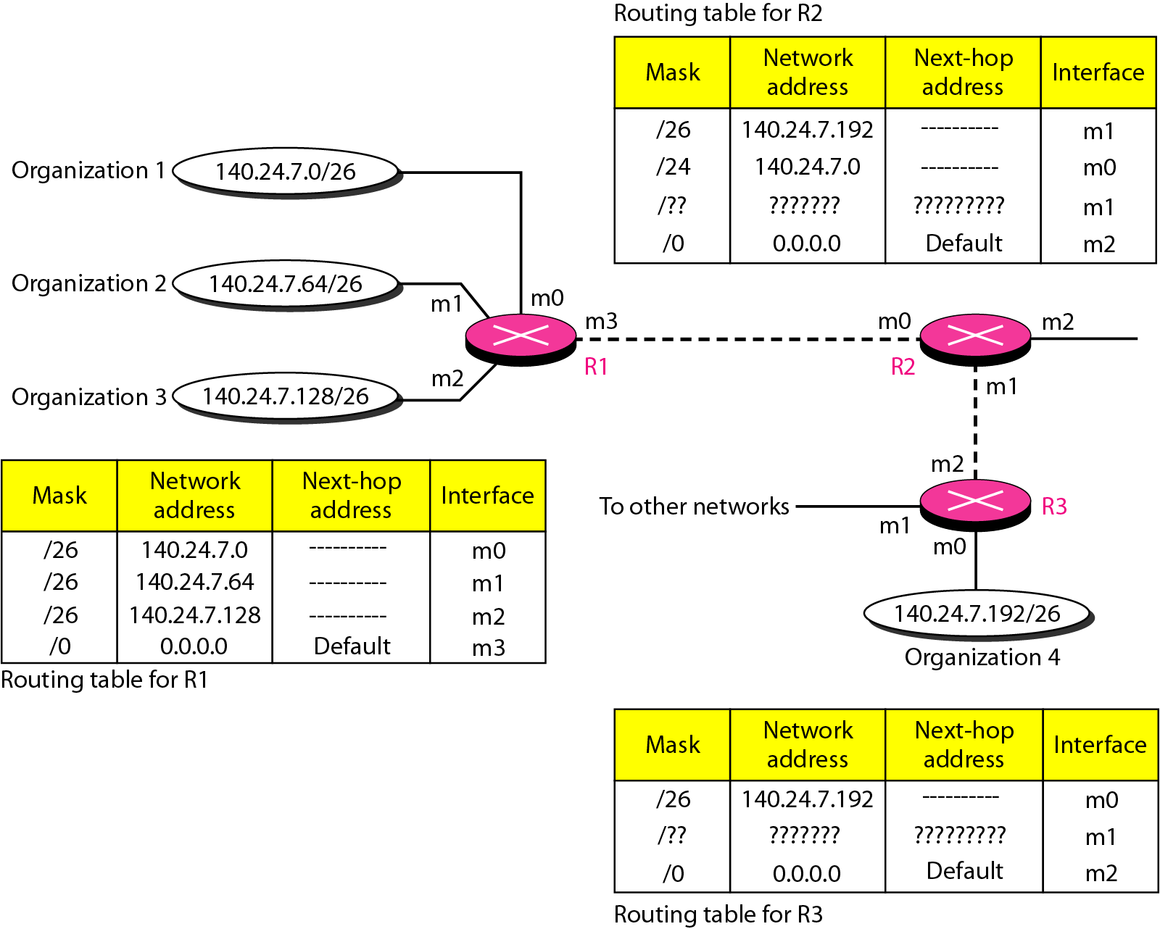
Longest Mask Matching

Slide 31
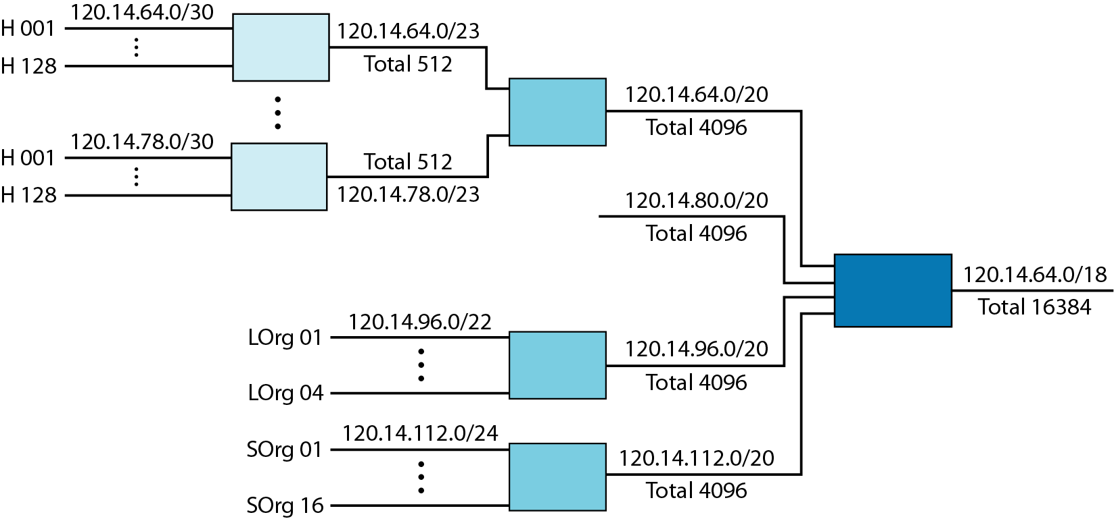
Hierarchical Routing
To solve the problem of gigantic routing tables

Slide 32
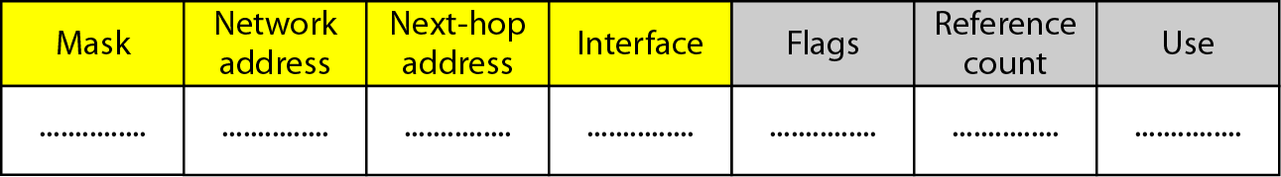
Routing Table
Static routing table: created manually
Dynamic routing table: updated periodically by using one of the dynamic routing protocols such as RIP, OSPF, or BGP
Common fields in a routing table
Flag: U(up), G(gateway), H(host-specific), D(added by redirection), M(modified by redirection)
Reference count: number of users of this route at the moment
Use: the number of packets transmitted through this router for the corresponding destination

Slide 33
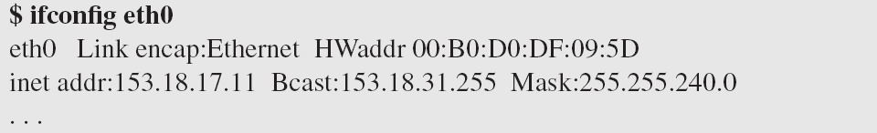
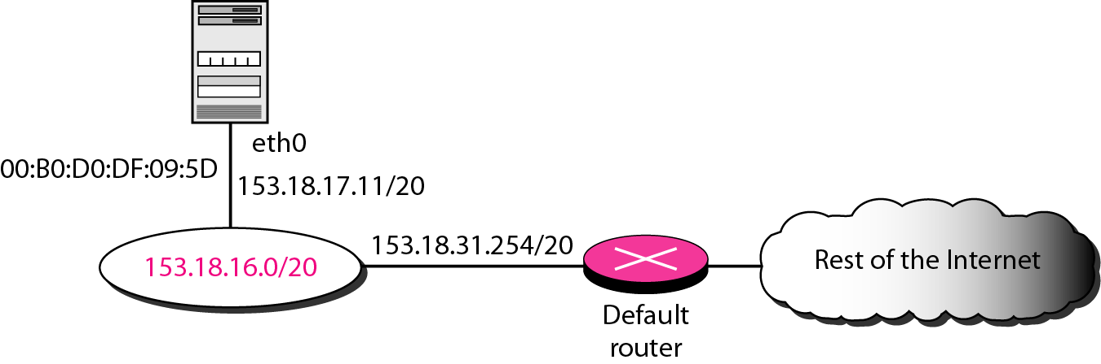
Utilities
To find the routing information and the contents of a routing table
netstat and ifconfig

Slide 34
Routing Protocols
A router consults a routing table when a packet is ready to be forwarded
The routing table specifies the optimum path for the packet: static or dynamic
Internet needs dynamic routing tables to be updated as soon as there is a change
Routing protocols is a combination of rules and procedures for dynamic routing tables
The routing protocols also include procedures for combining information received from other routers
Unicast routing and multicasting routing
RIP (Routing Information Protocol), OSPF (Open Shortest Path First), BGP (Border Gateway Protocol)

Slide 35
Optimization
Which of the available pathways is the optimum pathway ?
One approach is to assign a cost for passing through a network, called metric
Total metric is equal to the sum of the metrics of networks that comprise the route
Router chooses the route with shortest (smallest) metric
RIP (Routing Information Protocol): hop count
OSPF (Open Shortest Path First): allows administrator to assign a cost based on the type of service required
BGP (Border Gateway Protocol): criterion is the policy

